Slide 1
Astrophysical plasmas
Sun: coronal seismology
Exoplanet atmospheres
Sergio Elaskar - Matías Schneiter – Walkiria Schulz
Mariana Cécere - Andrés Cimino
Carlos Francile - Carlos Fernández
Sebastián Maglione
Nuevos integrantes:
Carolina Villarreal – Ernesto Zurbriggen
Andrea Costa
Notes:
1

Slide 2
Plasma parameters
Slow large-scale variations
Electrostatic vs Kinetic
Collective behaviour
Compressible Elastic
Magnetized plasma

Slide 3
Coronal phenomenology
Low corona magnetically highly structured system – X-Ray and EUV emission is highly structured
Tracer of magnetic field
The underlying chromosphere very dynamic: small scale structures and turbulent motion prevails
Notes:
3

Slide 4
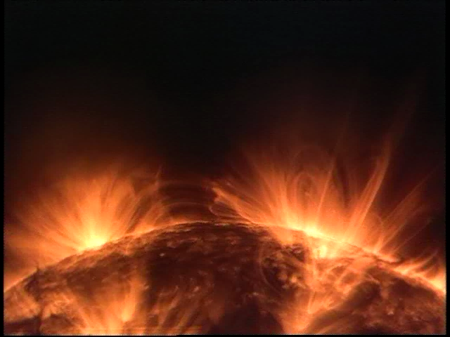
Notes:
4

Slide 5
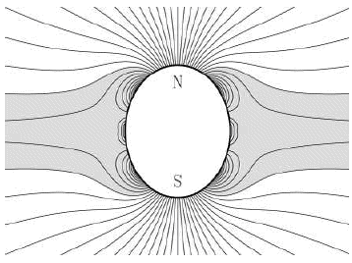
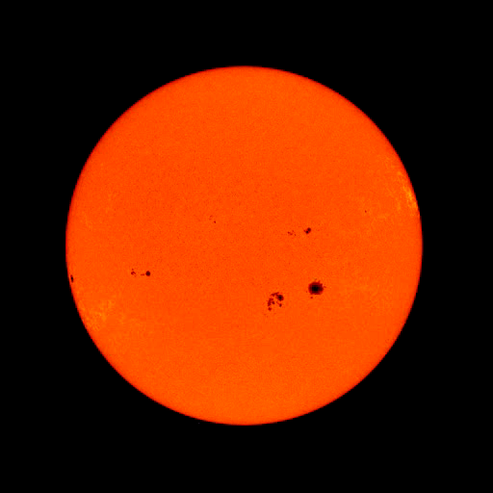
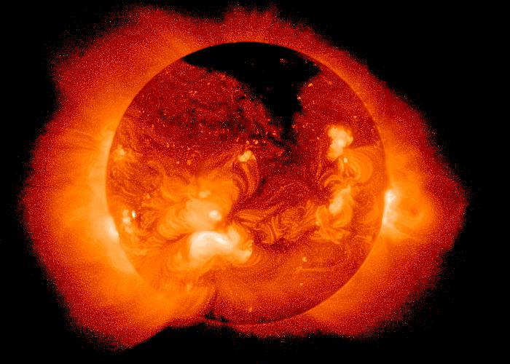
Coronal phenomenology- magnetized plasma
Large Reynolds number – field lines and plasma frozen
Corona: gas pressure << magnetic pressure
The magnetic field governs the dynamic
Chromosphere: magnetic pressure << gas pressure
The fluid governs the dynamic
Notes:
5

Slide 6
Importance of shock wave contribution for the seismology
Large Reynolds → frozen plasma – magnetic field
Gas pressure << magnetic pressure
Dynamic governed by the magnetic field
Sound speed << Alfvén speed
Energy: compressibility medium– elasticity medium
Inhomogeneity of the medium couples elastic perturbations with compressible ones. In the average transfer of energy to compressible modes
Favors the appearence of shock waves: compressive modes with Mach>1
Notes:
6

Slide 7
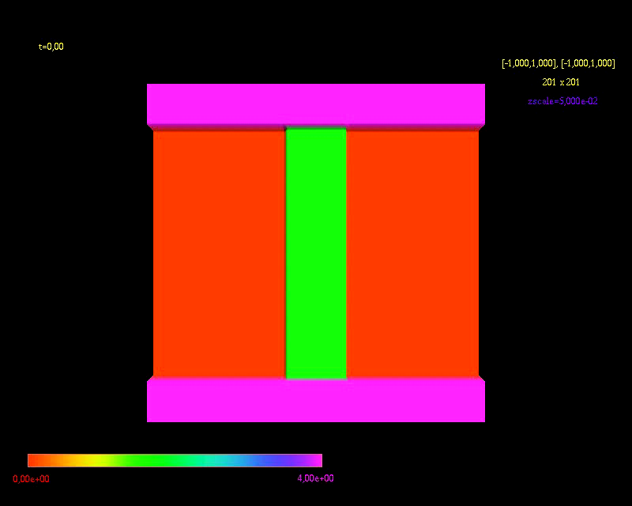
Simulations fundamental and global modes
Cécere, Costa, Reula A&A, 2011
Slender tube - Logaritmic – coronal conditions
Due to chromospheric line-tied
and inhomogeneities and nonlinearities
pure modes difficult to sustain
Jump conditions across the radius
amplifies the spectrum of modes
Trapped –Leaky
Evolution to a quasi-static 2nd slow
harmonic state occurs via the onset
of an external compressional Alfvén
wave or a weak shock wave M<1.3
that triggers the sausage mode and
couples the slow mode
Notes:
7

Slide 8
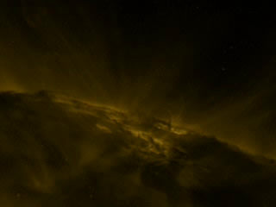
Costa, Elaskar, Fernández, Martínez, MNRAS 2009
Fernández, Costa, Elaskar, Schulz, 2009
Schulz, Costa, Elaskar, Cid, MNRAS 2010
Maglione, Schneiter, Costa, Elaskar, A&A 2011
Costa, Pl.Phis.Contr.Fusion, 2011
Interpretations:
Rain of blobs of dense and cool plasma after a CME falling gravitationally back
Flux tubes linking an above current sheet retract downwards under the force of the
magnetic tension
Top of colapsing loops with void tails in the wakes where reconnection occurs
Verwichte, Nakariakov, Cooper A&A, 2005 Observational analysis
Kink wave trains guided by ray tadpole structures. However speeds ~ vs not ~vA
Notes:
8

Slide 9
Notes:
9

Slide 10
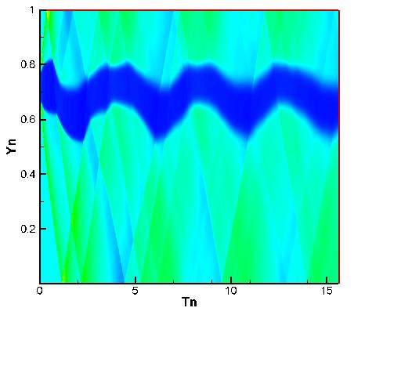
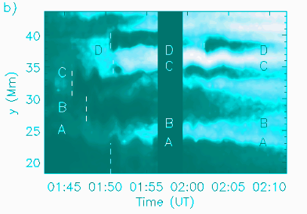
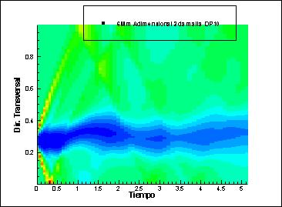
Notes:
10

Slide 11
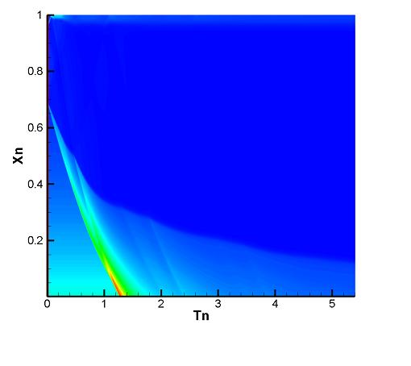
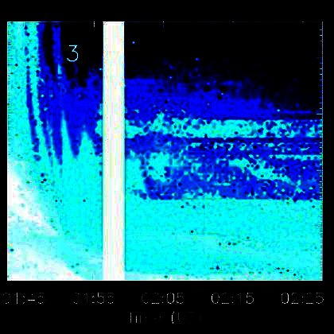
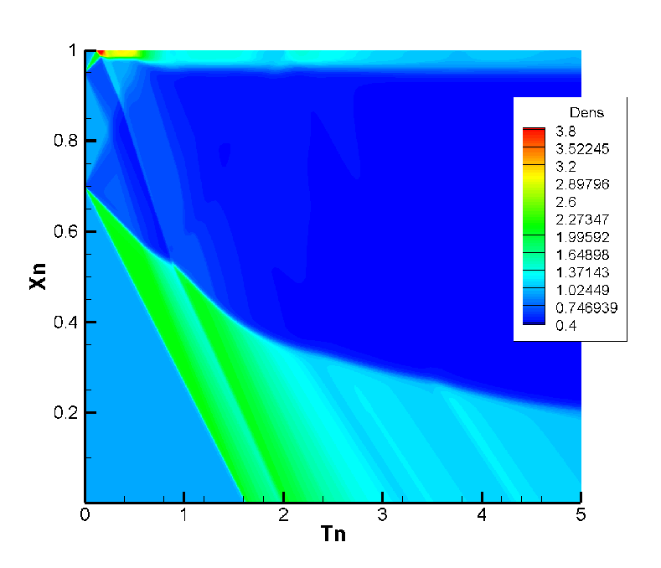
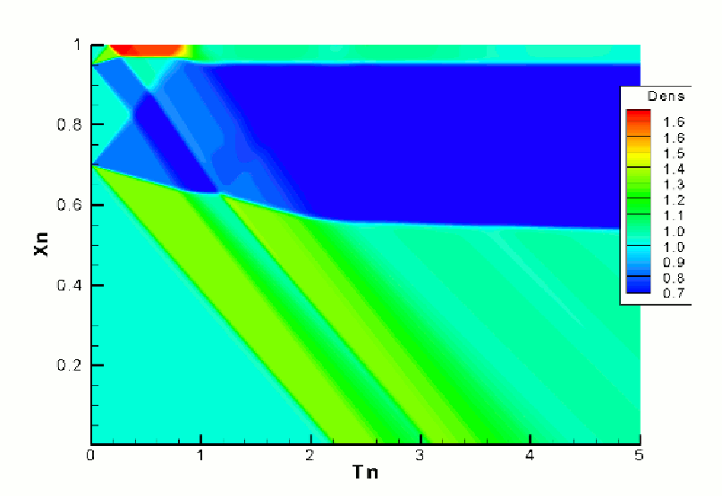
Sunward: upward rebound resembling the reconnection site absortion towards the Sun
Notes:
11

Slide 12
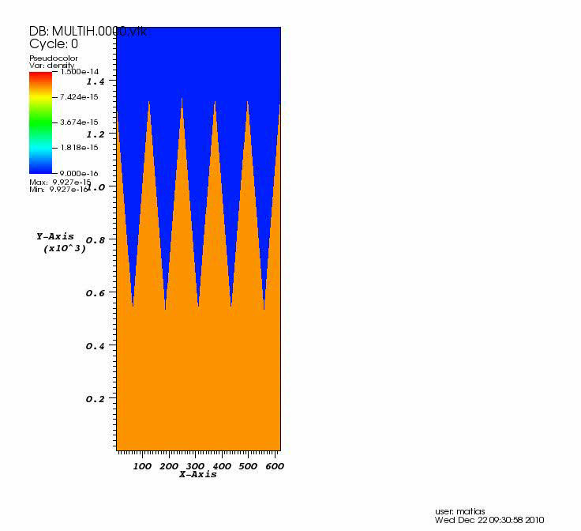
Schneiter, Costa, Elaskar, 2011
Notes:
12

Slide 13
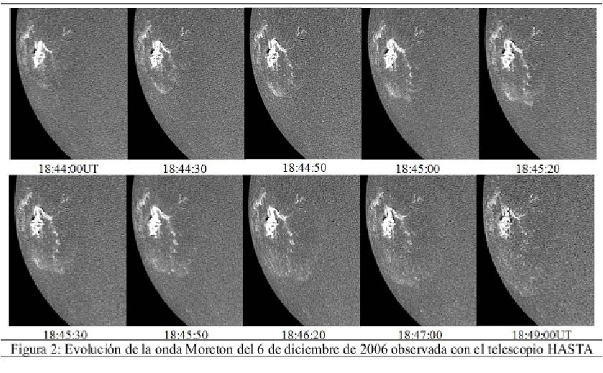
Moreton waves
Francile, Costa, Schneiter, Elaskar, 2011
Chromospheric shock waves or fast magnetoacoustic wave
Triggered by a not stablished coronal phenomenon

Slide 14
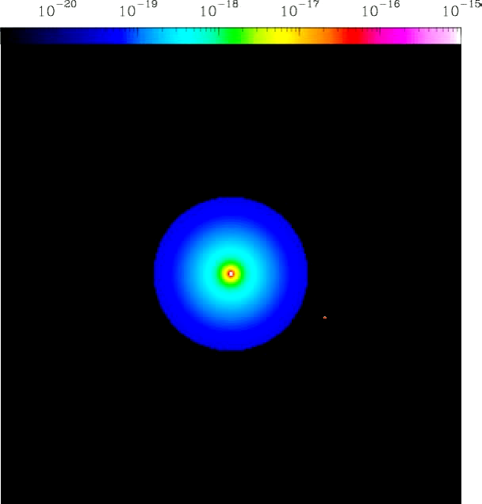
Exoplanet atmospheres: we derive the L_Alpha absortion for different wind conditions
Schneiter,Velázquez,Raga, 2007-Villareal,Schneiter,Costa, 2011-Schneiter, Costa, Velázquez, 2011
HD209458b
HD17156b

Slide 15
Thank you
Notes:
15

